Slide 1
Experiments

Slide 2
Pre-registeration

Slide 3
Pre-registeration

Slide 4
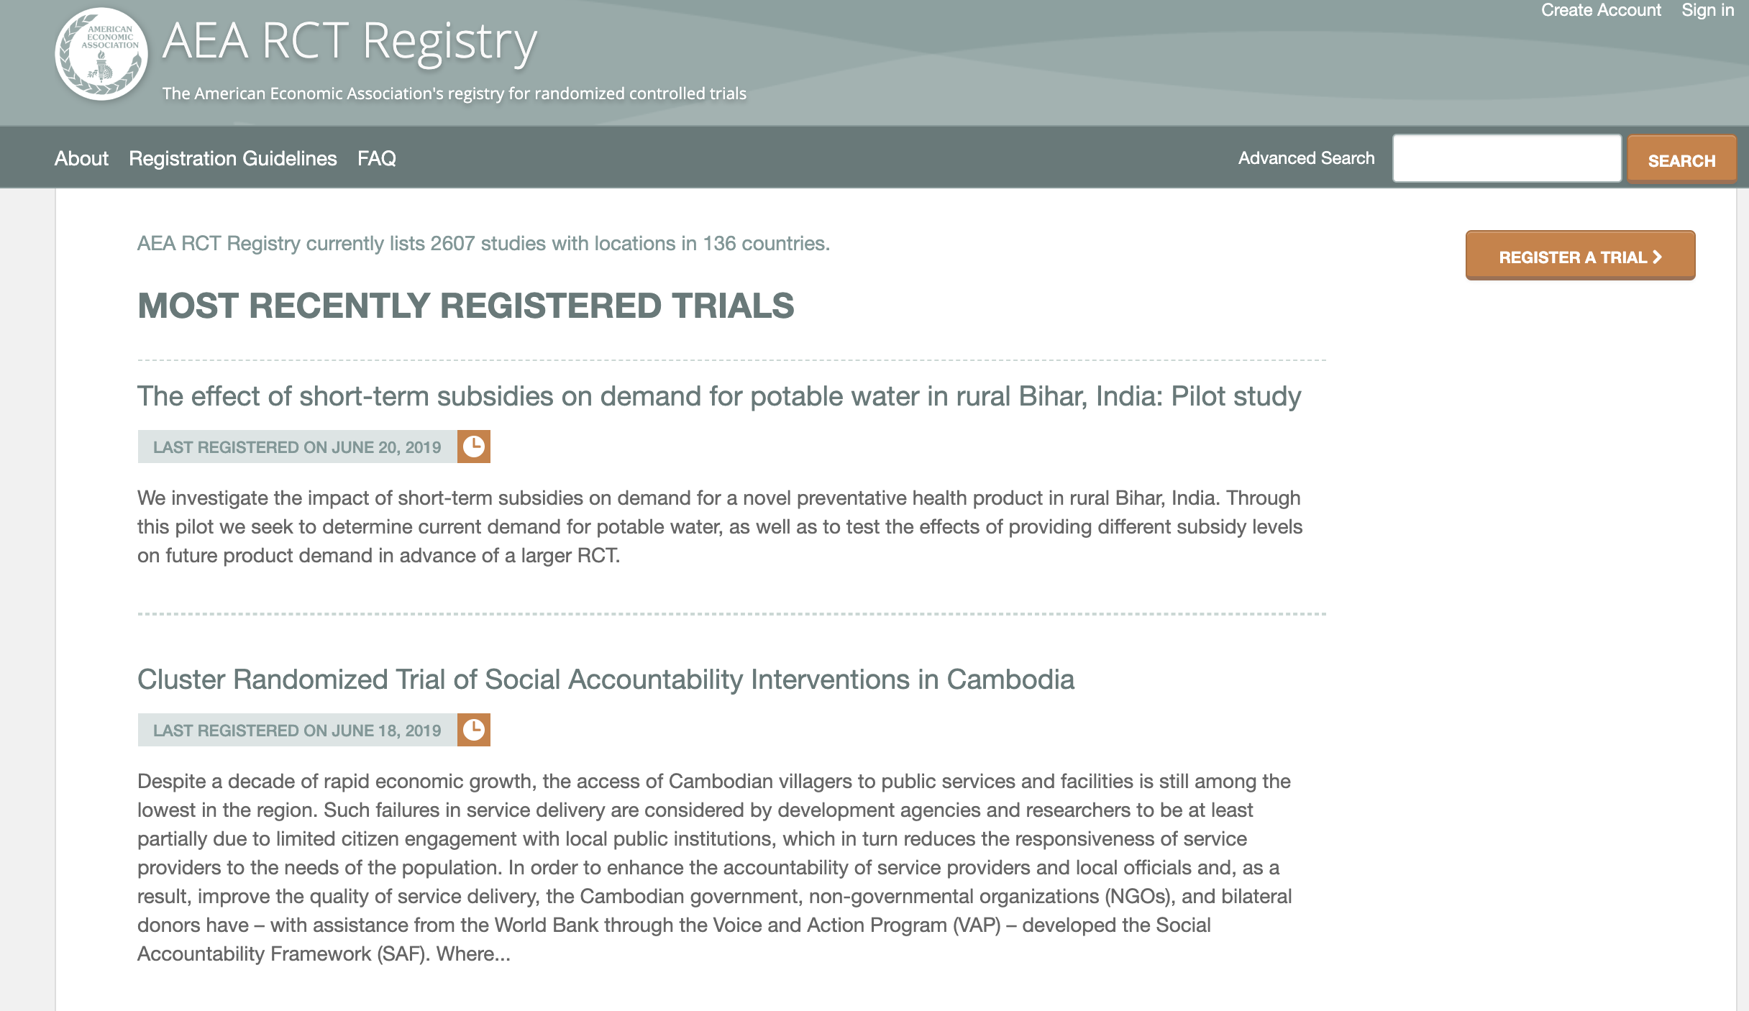


Slide 5
How we experiment?
Labratory
In-the-wild
Natural

Slide 6
How do we experiment
Cost
Control
Realism / Ecological validity
Ethics

Slide 7
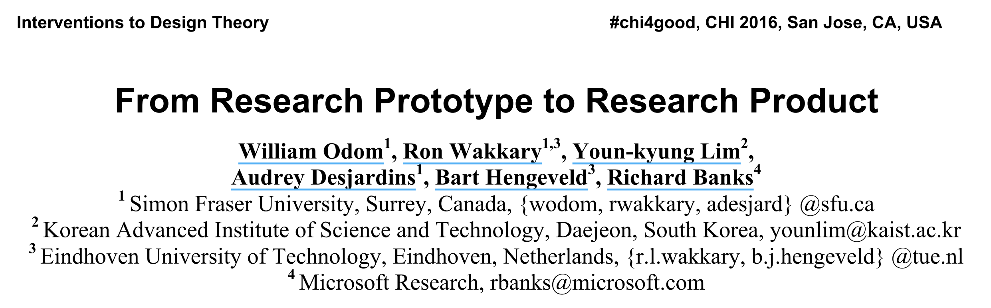

Slide 8
Between subjects vs. within subjects

Slide 9
Survey (vingette) experiment
Survey part B1
Survey part A
Survey part C
Survey part B2

Slide 10
Survey (vingette) experiment
Survey part B1
Survey part A
Survey part C
Survey part B2

Slide 11
Experiments – temporal effects
Condition A
Condition B
Condition C

Slide 12
Experiments – temporal effects
Condition A
Condition B
Condition C
A | B | C
B | C | A
C | A | B
Latin square

Slide 13


Slide 14
Beyond boring experiments

Slide 15
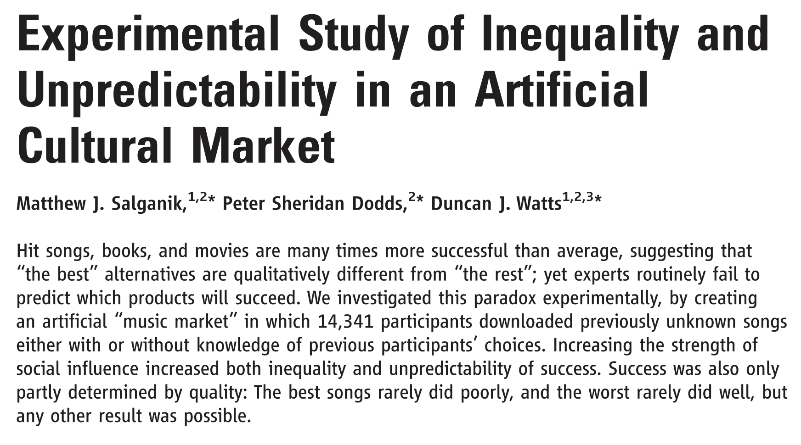

Slide 16
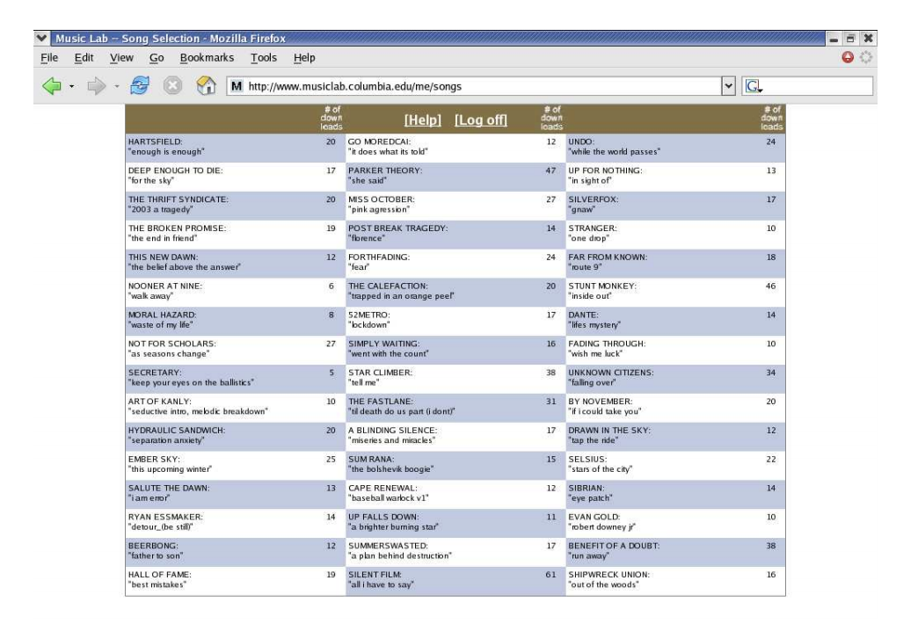

Slide 17
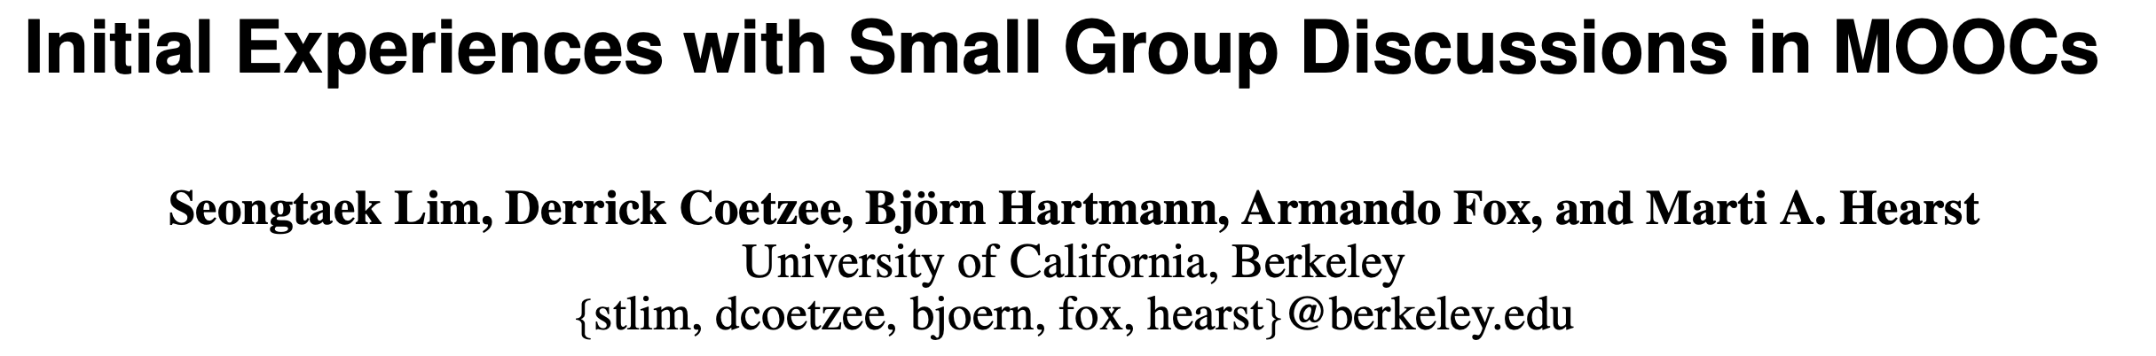

Slide 18
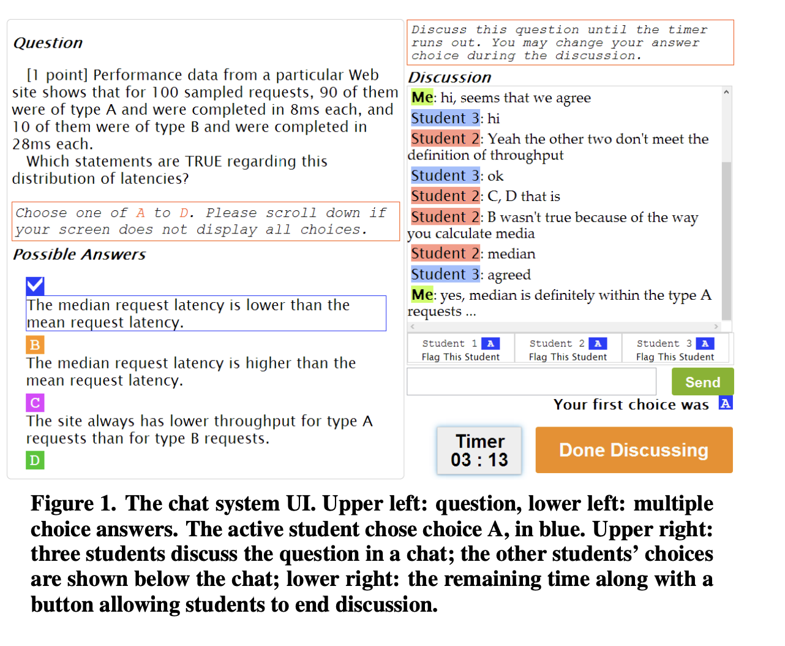

Slide 19
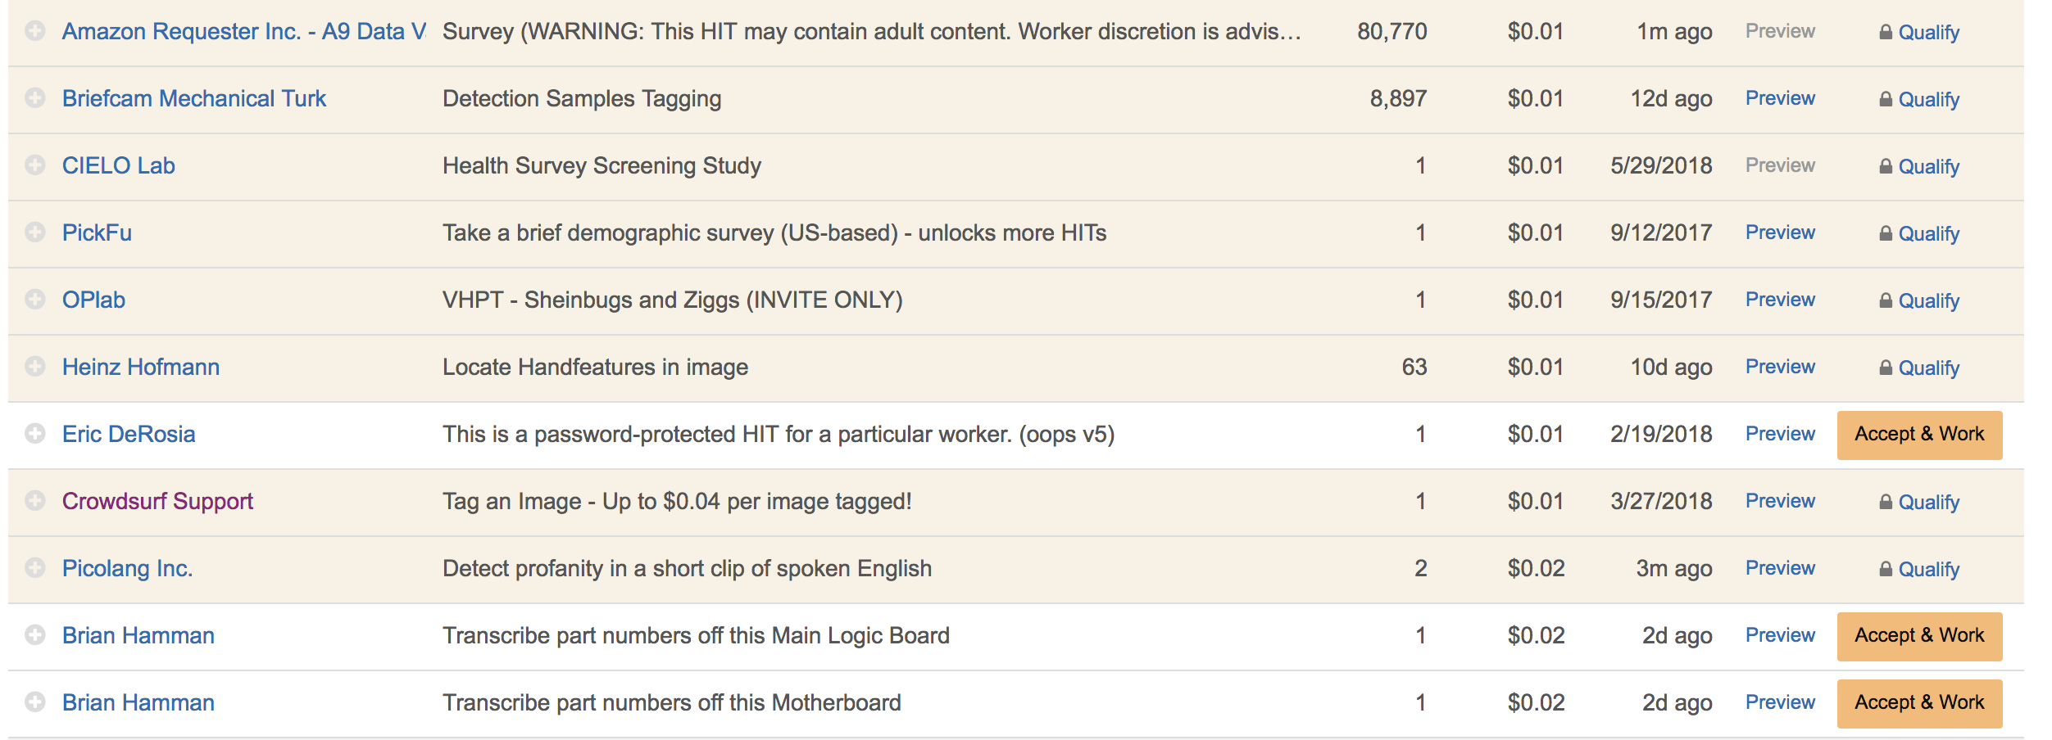
Opportunity: every other kind of HITs

Slide 20
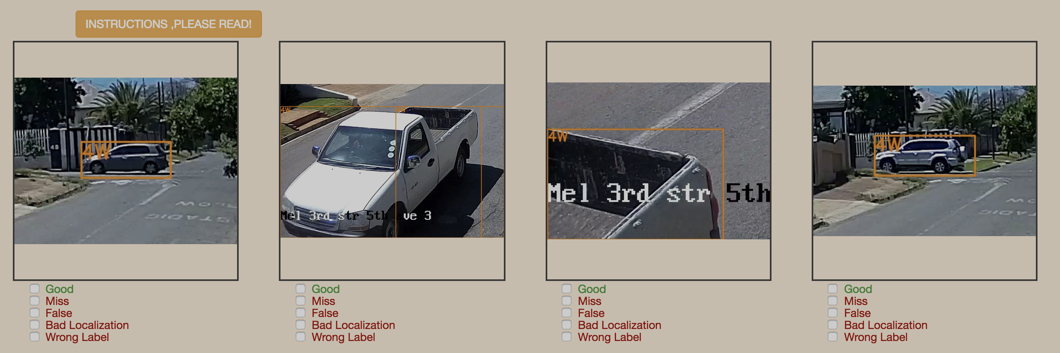
Opportunity: every other kind of HITs

Slide 21
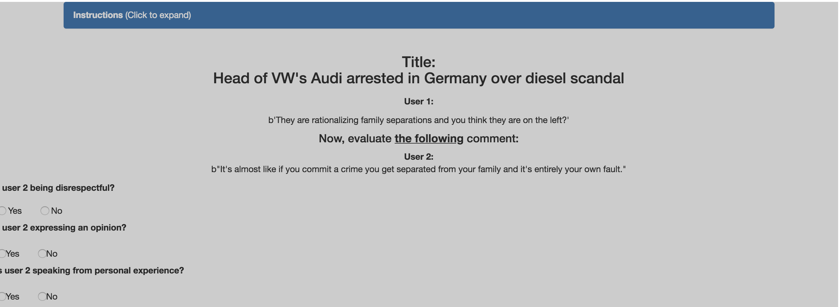
Opportunity: every other kind of HITs

Slide 22
But…

Slide 23
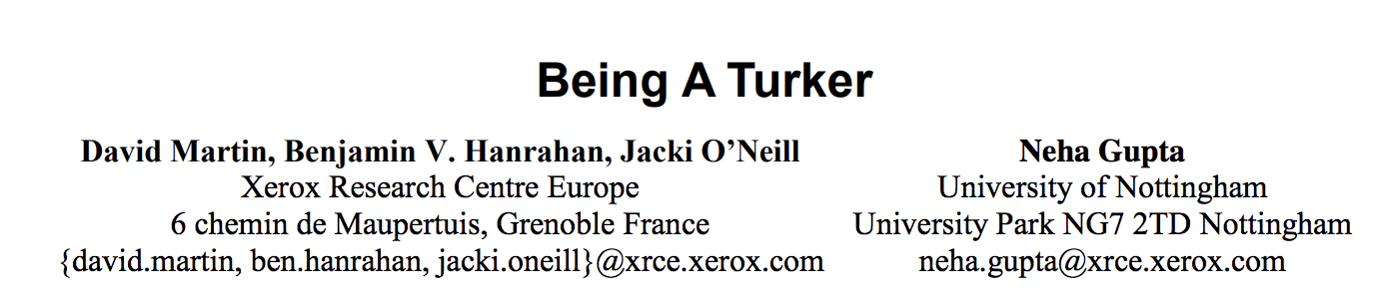

Challenge: Turkers are humans

Slide 25
Turkers as new college students?

